Slide 1


Create payment
Charge payment
Refund payment
Additional notes
Important information when integrating
by Nicolai Ortiz Echeverria

Slide 2
Create payment
Charge payment
Refund payment
Additional notes
Useful links

Slide 4
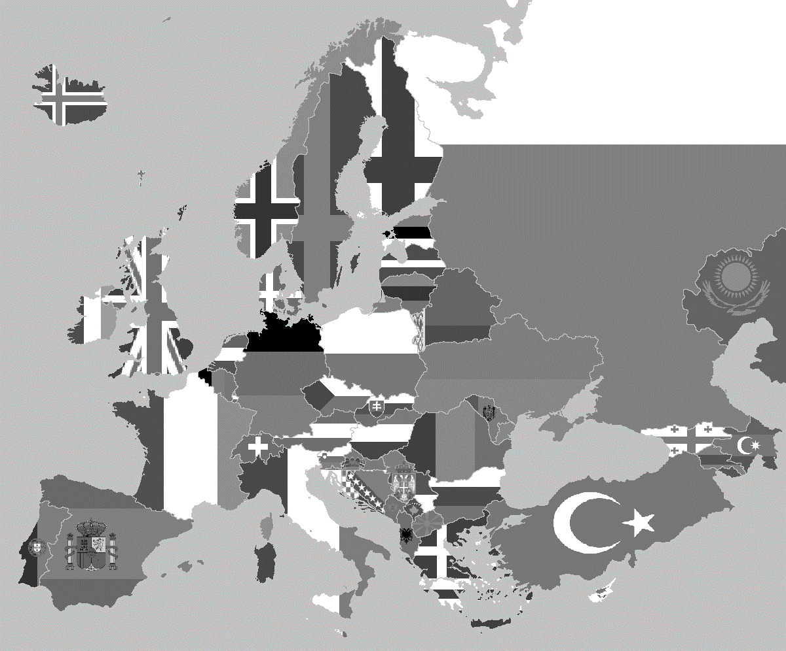
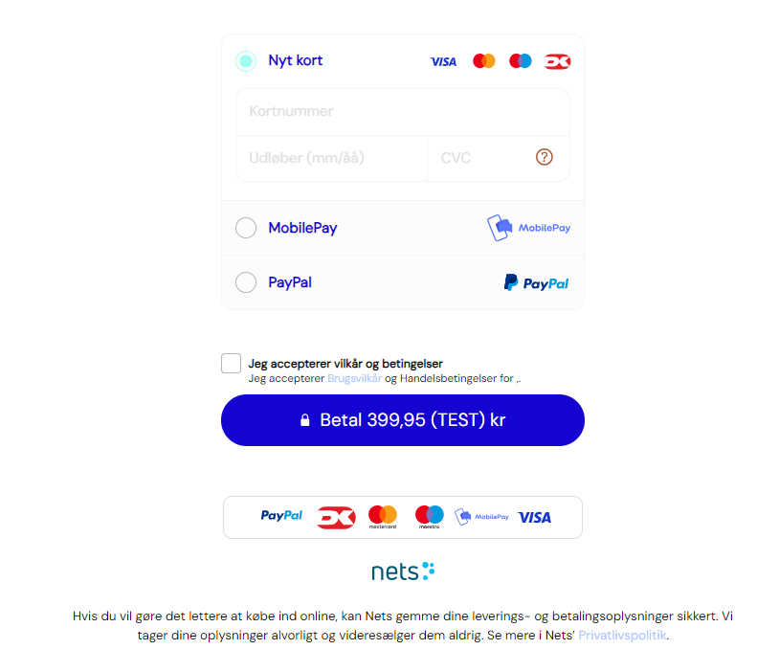
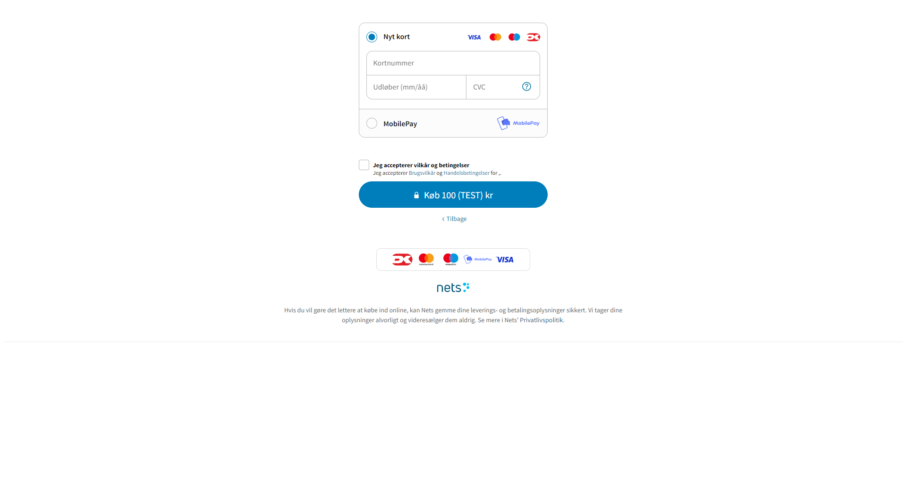

Slide 5
Hosted
Payment window scales automatically with resolution of screen used
Links generated can be used in multiple scenarios
If the payment fails, the customer can always return to the same link until a reservation has been made on the paymentId
Embedded
More seamless checkout
Customer stays on your site
Additional options for styling with instant reaction
Integration type – Hosted or Embedded?

Slide 6
Hosted
Payment window scales automatically with resolution of screen used
Links generated can be used in multiple scenarios
If the payment fails, the customer can always return to the same link until a reservation has been made on the paymentId
Embedded
More seamless checkout
Customer stays on your site
Additional options for styling with instant reaction

Slide 7
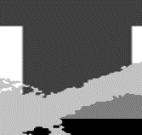



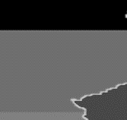
Next question, which payment type to use?
2
1
3
4
Let’s go through the different options
5

Slide 8
Test environment
Amount ranges with special meanings
- There’s 2 ranges you need to be aware of when testing.
If you create a payment with 1,xx as amount, your payment will be rejected with the amount stated as cents/pennies/ears. For example if you use 1,51 as amount, the payment will be rejected with action code 51.
The other ranges is 3,xx. The cents/pennies/ears stated will determine how long it will take to redirect towards the 3DS simulator. For instance 3,10 as amount will delay the redirection with 10 seconds.
Consumer information
You can either send in the consumer information or have the consumer fill in their details themselves in the payment window. This is determined by setting merchantHandlesConsumerData to false (consumer fills in their details manually) and true (consumer details sent in at payment creation)
If you do not have the consumer data or do not wish to have it sent in, you can set merchantHandlesConsumerData to true without a consumer object.
Good to know
For embedded, your site needs to have an SSL certificate (url starts with https://) when stating the url in the checkout object, the url stated needs to be the exact path for where you are loading in the embedded checkout.
Amount should always be stated in cents/pennies/ears. 100,00 should therefore be stated as 10000. An example of this can be found in next topic (2)
noech
1
General information no matter transaction type
Single payment request

Slide 9

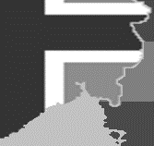
2
1
3
4
5
Single payment request

Slide 10
Order object
Checkout object
Paytype filter & webhook
2
{
"order": {
"items": [
{
"reference": "item number",
"name": "This is the item/product name",
"unit": "stk",
"unitPrice": 2000, ///20,00
"quantity": 2,
"taxRate":2500, ///25,00 percent
"taxAmount":1000,
"grossTotalAmount": 5000, ///Total price for order including tax
"netTotalAmount": 4000 ///Summed up (unitPrice * quantity)
},
{
"reference": "Discount",
"name": "Discount/voucher",
"unit": "stk",
"unitPrice": -1000,
"quantity": 1,
"grossTotalAmount": -1000,
"netTotalAmount": -1000
}
],
"reference": "This is your order number/orderId",
"amount": 4000,
"currency": "DKK"
},
"checkout": {
"integrationType": "HostedPaymentPage",
"returnUrl": "https://www.nets.eu/where_should_the_customer_be_directed_to_after_paying?",
/*"url":"https://www.where-is-your-checkout-located.com" replaces returnUrl for EmbeddedCheckout instead */
"cancelUrl": "https://www.nets.eu/cancelPage",
"termsUrl": "https://www.nets.eu/your-Terms-and-Condition-page-when-a-customer-makes-a-purchase",
"charge": true, /* If set to true, the transaction will be charged immediately after a successful reservation has taken place */
"publicDevice": true, /* States whether the consumer will be able to save their information in Easy. If set to true, consumer will not be able to save their information */
"merchantTermsUrl": "https://www.nets.eu/cookie-and-privacy-settings-for-merchant",
"merchantHandlesConsumerData": true,
"appearance": {
"displayOptions": {
"showMerchantName": false,
"showOrderSummary": false
}
},
"textOptions": {
"completePaymentButtonText": "signup" //select between: pay, purchase, order, book, reserve, signup, storecard, subscribe and accept. These are localized
},
"consumer": {
"reference": "consumerReference",
"email": "test@test.dk",
"shippingAddress": {
"addressLine1": "Testgade 1, st.th",
"addressLine2": null,
"postalCode": "2300",
"city": "København S",
"country": "DNK"
},
"phoneNumber": {
"prefix": "+45",
"number": "11223344"
},
"privatePerson": {
"firstName": "Test",
"lastName": "Testesen"
}
}
},
"paymentMethodsConfiguration":[
{
"name":"Visa",
"enabled":true
},
{
"name":"MasterCard",
"enabled":true
}
],
"myReference": "internalReference", ///Max 36 characters. Will appear in payout reports
"notifications":{
"webHooks":[
{
"eventName":"webhook event you wish to subscribe to",
"url":"which server should the message be delivered to?",
" authorization":"password to your server. If no password is required, 8+ characters are needed"
}
]
}
}
(Full payload can be found here)
Single payment creation request

Slide 11
Checkout object
Paytype filter & webhook
"checkout": {
"integrationType": "HostedPaymentPage",
"returnUrl": "https://www.nets.eu/where_should_the_customer_be_directed_to_after_paying?",
/*"url":"https://www.where-is-your-checkout-located.com" replaces returnUrl for EmbeddedCheckout instead */
"cancelUrl": "https://www.nets.eu/cancelPage",
"termsUrl": "https://www.nets.eu/your-Terms-and-Condition-page-when-a-customer-makes-a-purchase",
"charge": true,
"publicDevice": true, /* States whether the consumer will be able to save their information in Easy. If set to true, consumer will not be able to save their information */
"merchantTermsUrl": "https://www.nets.eu/cookie-and-privacy-settings-for-merchant",
"merchantHandlesConsumerData": true,
"appearance": {
"displayOptions": {
"showMerchantName": false,
"showOrderSummary": false
}
},
"textOptions": {
"completePaymentButtonText": "signup" //select between: pay, purchase, order, book, reserve, signup, storecard, subscribe and accept. These are localized
},
"consumer": {
"reference": "consumerReference",
"email": "test@test.dk",
"shippingAddress": {
"addressLine1": "Testgade 1, st.th",
"addressLine2": null,
"postalCode": "2300",
"city": "København S",
"country": "DNK"
},
"phoneNumber": {
"prefix": "+45",
"number": "11223344"
},
"privatePerson": {
"firstName": "Test",
"lastName": "Testesen"
}
}
},
"paymentMethodsConfiguration":[
{
"name":"Visa",
"enabled":true
},
{
"name":"MasterCard",
"enabled":true
}
],
"myReference": "internalReference", ///Max 36 characters. Will appear in payout reports
"notifications":{
"webHooks":[
{
"eventName":"webhook event you wish to subscribe to",
"url":"which server should the message be delivered to?",
" authorization":"password to your server. If no password is required, 8+ characters are needed"
}
]
}
}
Order object
order.reference – the order number identifying the order request (will also be included in your payout reports)
order.currency – If you have multi-currency added to your account, the currency will distinguish between payment methods available via the currency specified and only present payment methods available for the specified currency. For instance if you have MobilePay on DKK and Vipps on NOK, it will present MobilePay when DKK is set as currency and Vipps when NOK is set as currency.
Order.items.taxRate/taxAmount – These values are optional for the most part, but for certain payment methods, it’s required (Usually for invoice/installment payments and A2A payments.
2
{
"order": {
"items": [
{
"reference": "item number",
"name": "This is the item/product name",
"unit": "stk",
"unitPrice": 2000, ///20,00
"quantity": 2,
"taxRate":2500, ///25,00 percent
"taxAmount":1000,
"grossTotalAmount": 5000, ///Total price for order including tax
"netTotalAmount": 4000 ///Summed up (unitPrice * quantity)
},
{
"reference": "Discount",
"name": "Discount/voucher",
"unit": "stk",
"unitPrice": -1000,
"quantity": 1,
"grossTotalAmount": -1000,
"netTotalAmount": -1000
}
],
"reference": "This is your order number/orderId",
"amount": 4000,
"currency": "DKK"
},
Single payment creation request

Slide 12
Paytype filter & webhook
"paymentMethodsConfiguration":[
{
"name":"Visa",
"enabled":true
},
{
"name":"MasterCard",
"enabled":true
}
],
"myReference": "internalReference", ///Max 36 characters. Will appear in payout reports
"notifications":{
"webHooks":[
{
"eventName":"webhook event you wish to subscribe to",
"url":"which server should the message be delivered to?",
“authorization":"password to your server. If no password is required, 8+ characters are needed"
}
]
}
}
Checkout object
integrationType – ”HostedPaymentPage” (redirect to Nets-Nexi hosted page) or ”EmbeddedCheckout” (checkout called on your own website as an embedded element or overlay)
returnUrl – (hosted) page specified for where the customer should be redirected to when completing their checkout
url – (embedded) url specifying where the embedded checkout is loaded up.
cancelUrl – (hosted) (optional) where should the consumer be redirected to when clicking on the ”Go back” button?
termsUrl – your terms & conditions location where the consumer can read about your policies for the purchase.
merchantTermsUrl – (optional) your own terms of privacy policy.
merchantHandlesConsumerData – (optional, default set to false)
true: consumer information is sent in the request. Address, name and contact information is not requested in the checkout window.
false: address, name and contact details are requested to be filled out in the checkout window.
textOptions.completePaymentButtonText – (optional) the options shown (pay, purchase, order, book, reserve, signup, storecard, subscribe or accept) are the ones available for changing the wording on the button. When changing language, the specified choice will match for the specified language as well.
Consumer – (optional) certain payment methods does require the information such as invoice, installment and A2A payment methods)
2
"checkout": {
"integrationType": "HostedPaymentPage",
"returnUrl": "https://www.nets.eu/where_should_the_customer_be_directed_to_after_paying?",
/*"url":"https://www.where-is-your-checkout-located.com" replaces returnUrl for EmbeddedCheckout instead */
"cancelUrl": "https://www.nets.eu/cancelPage",
"termsUrl": "https://www.nets.eu/your-Terms-and-Condition-page-when-a-customer-makes-a-purchase",
"charge": true,
"publicDevice": true, /* States whether the consumer will be able to save their information in Easy. If set to true, consumer will not be able to save their information */
"merchantTermsUrl": "https://www.nets.eu/cookie-and-privacy-settings-for-merchant",
"merchantHandlesConsumerData": true,
"appearance": {
"displayOptions": {
"showMerchantName": false,
"showOrderSummary": false
}
},
"textOptions": {
"completePaymentButtonText": "signup" //select between: pay, purchase, order, book, reserve, signup, storecard, subscribe and accept. These are localized
},
"consumer": {
"reference": "consumerReference",
"email": "test@test.dk",
"shippingAddress": {
"addressLine1": "Testgade 1, st.th",
"addressLine2": null,
"postalCode": "2300",
"city": "København S",
"country": "DNK"
},
"phoneNumber": {
"prefix": "+45",
"number": "11223344"
},
"privatePerson": {
"firstName": "Test",
"lastName": "Testesen"
}
}
},
Single payment creation request

Slide 13
Paytype filter & webhook
paymentMethodsConfiguration – (optional) can be used to determine which payment methods you wish to have shown. This can for example be used if you do not wish to have certain payment methods shown if the amount is above a threshhold via logic on your end as an example.
myReference – (optional) an additional reference which will be included in your settlement reports. This additional reference can also be added in your charge or refund requests – most common usage is for automization of bookkeeping or to differentiate between partial charges/refunds
Webhooks – (strongly recommended) Webhooks are used to notify you about which state each transaction has. There is multiple webhook events and multiple can be added in the creation of the payment request which will be saved in Easy for later usage such as for cancel, charge or refund of the specific transaction.
2
"paymentMethodsConfiguration":[
{
"name":"Visa",
"enabled":true
},
{
"name":"MasterCard",
"enabled":true
}
],
"myReference": "internalReference", ///Max 36 characters. Will appear in payout reports
"notifications":{
"webHooks":[
{
"eventName":"webhook event you wish to subscribe to",
"url":"which server should the message be delivered to?",
“authorization":"password to your server. If no password is required, 8+ characters are needed"
}
]
}
}
Single payment creation request

Slide 14

Do’s and don’t
If you wish to create a subscription but without an amount planned to be charged after, please make sure to state the amount as 0 to ensure no reservation amount is created. This is important since it can lead to schemes handing out fines.
During your integration, it’s important to determine how large of a volume of subscriptions you expect to charge each month, which will be covered in the later chapters, but like with single payments, it’s strongly recommended to make use of a particular webhook: “payment.reservation.created.v2”, since this webhook contains the subscriptionId when it has been created. For subscription charges and webhooks, it depends on how large a volume of subscriptions you expect to have processed.
2
1
3
4
5
Regular: This recurring type is primarily used for recurring subscriptions where the amount and/or interval is static each month. Due to this, you need to add an expiry date for the subscription during the creation of the subscriptionId
UCOF (Unscheduled Card On File): This subscription type allows for both the amount and intervals of charging to vary, however the subscription will automatically expire after having been inactive for roughly 365 days.
There’s 2 types of verification.
- Card verification when the subscriber initiates and approves the creation of the subscription
- Before you run your bulk runs, you can make a bulk verification to validate whether the card or subscription is experiencing any issues. This will be explained more in detail in later slides.

Slide 15
Regular: This recurring type is primarily used for recurring subscriptions where the amount and/or interval is static each month. Due to this, you need to add an expiry date for the subscription during the creation of the subscriptionId
UCOF (Unscheduled Card On File): This subscription type allows for both the amount and intervals of charging to vary, however the subscription will automatically expire after having been inactive for roughly 365 days.
Do’s and don’t
If you wish to create a subscription but without an amount planned to be charged after, please make sure to state the amount as 0 to ensure no reservation amount is created. This is important since it can lead to schemes handing out fines.
During your integration, it’s important to determine how large of a volume of subscriptions you expect to charge each month, which will be covered in the later chapters, but like with single payments, it’s strongly recommended to make use of a particular webhook: “payment.reservation.created.v2”, since this webhook contains the subscriptionId when it has been created. For subscription charges and webhooks, it depends on how large a volume of subscriptions you expect to have processed.
There’s 2 types of verification.
- Card verification when the subscriber initiates and approves the creation of the subscription
- Before you run your bulk runs, you can make a bulk verification to validate whether the card or subscription is experiencing any issues. This will be explained more in detail in later slides.
3
3
Regular subscription creation payload example
UCOF subscription creation payload example
Subscription type
Card verification
  {
  "order": {
  "items": [
  {
  "reference": “sub11992288",
  "name": “Subscription item example",
  "quantity": 1,
  "unit": "stk",
  "unitPrice": 0,
  "taxRate": 0,
  "taxAmount": 0,
  "netTotalAmount": 0,
  "grossTotalAmount": 0
  }
  ],
  "amount": 0,
  "currency": "DKK",
  "reference": “119911-5522-EE-9112"
  },
  "checkout": {
  "termsUrl": "https://www.nets.eu",
  "returnUrl": "https://www.nets.eu",
  "cancelUrl": "https://www.nets.eu",
  "publicDevice": true,
  "charge": false,
  "integrationType": "HostedPaymentPage",
  "merchantHandlesConsumerData": true
  },
  "subscription":{
  "interval":0,
  "endDate":"2055-01-01Z“ ///Specifies when the subscription will expire (Not the same as when the card will expire)
  },
  "notifications":{
  "webHooks":[
  {
  "eventName":"payment.reservation.created.v2",
  "url":"https://webhook.site/090117b0-c7cd-4682-8458-1b75b3d7dc63",
  "authorization":"123456789"
  }
  ]
  }
  }
  {
  "order": {
  "items": [
  {
  "reference": "sub11992288",
  "name": "Subscription item example",
  "quantity": 1,
  "unit": "stk",
  "unitPrice": 0,
  "taxRate": 0,
  "taxAmount": 0,
  "netTotalAmount": 0,
  "grossTotalAmount": 0
  }
  ],
  "amount": 0,
  "currency": "DKK",
  "reference": "119911-5522-EE-9112"
  },
  "checkout": {
  "integrationType": "HostedPaymentPage",
  "returnUrl": "https://www.nets.eu/where_should_the_customer_be_directed_to_after_paying?",
  /*"url":"https://www.where-is-your-checkout-located.com" replaces returnUrl for EmbeddedCheckout instead */
  "cancelUrl": "https://www.nets.eu/cancelPage",
  "termsUrl": "https://www.nets.eu/your-Terms-and-Condition-page-when-a-customer-makes-a-purchase",
  "charge": false,
  "publicDevice": true, /* States whether the consumer will be able to save their information in Easy. If set to true, consumer will not be able to save their information */
  "merchantTermsUrl": "https://www.nets.eu/cookie-and-privacy-settings-for-merchant",
  "merchantHandlesConsumerData": true
  },
  "unscheduledSubscription": {
  "create": true
  },
  "notifications": {
  "webHooks": [
  {
  "eventName": "payment.reservation.created.v2",
  "url": "{{webhookUrl}}",
  "authorization": "123456789"
  },
  {
  "eventName": "payment.reservation.failed",
  "url": "{{webhookUrl}}",
  "authorization": "123456789"
  }
  ]
  }
  }
Subscription creation request

Slide 16
Regular: This recurring type is primarily used for recurring subscriptions where the amount and/or interval is static each month. Due to this, you need to add an expiry date for the subscription during the creation of the subscriptionId
UCOF (Unscheduled Card On File): This subscription type allows for both the amount and intervals of charging to vary, however the subscription will automatically expire after having been inactive for roughly 365 days.
Do’s and don’t
If you wish to create a subscription but without an amount planned to be charged after, please make sure to state the amount as 0 to ensure no reservation amount is created. This is important since it can lead to schemes handing out fines.
During your integration, it’s important to determine how large of a volume of subscriptions you expect to charge each month, which will be covered in the later chapters, but like with single payments, it’s strongly recommended to make use of a particular webhook: “payment.reservation.created.v2”, since this webhook contains the subscriptionId when it has been created. For subscription charges and webhooks, it depends on how large a volume of subscriptions you expect to have processed.
There’s 2 types of verification.
- Card verification when the subscriber initiates and approves the creation of the subscription
- Before you run your bulk runs, you can make a bulk verification to validate whether the card or subscription is experiencing any issues. This will be explained more in detail in later slides.
3
Regular subscription creation payload example
UCOF subscription creation payload example
Subscription type
Card verification
  {
  "order": {
  "items": [
  {
  "reference": “sub11992288",
  "name": “Subscription item example",
  "quantity": 1,
  "unit": "stk",
  "unitPrice": 0,
  "taxRate": 0,
  "taxAmount": 0,
  "netTotalAmount": 0,
  "grossTotalAmount": 0
  }
  ],
  "amount": 0,
  "currency": "DKK",
  "reference": “119911-5522-EE-9112"
  },
  "checkout": {
  "termsUrl": "https://www.nets.eu",
  "returnUrl": "https://www.nets.eu",
  "cancelUrl": "https://www.nets.eu",
  "publicDevice": true,
  "charge": false,
  "integrationType": "HostedPaymentPage",
  "merchantHandlesConsumerData": true
  },
  "subscription":{
  "interval":0,
  "endDate":"2055-01-01Z“ ///Specifies when the subscription will expire (Not the same as when the card will expire)
  },
  "notifications":{
  "webHooks":[
  {
  "eventName":"payment.reservation.created.v2",
  "url":"https://webhook.site/090117b0-c7cd-4682-8458-1b75b3d7dc63",
  "authorization":"123456789"
  }
  ]
  }
  }
  {
  "order": {
  "items": [
  {
  "reference": "sub11992288",
  "name": "Subscription item example",
  "quantity": 1,
  "unit": "stk",
  "unitPrice": 0,
  "taxRate": 0,
  "taxAmount": 0,
  "netTotalAmount": 0,
  "grossTotalAmount": 0
  }
  ],
  "amount": 0,
  "currency": "DKK",
  "reference": "119911-5522-EE-9112"
  },
  "checkout": {
  "integrationType": "HostedPaymentPage",
  "returnUrl": "https://www.nets.eu/where_should_the_customer_be_directed_to_after_paying?",
  /*"url":"https://www.where-is-your-checkout-located.com" replaces returnUrl for EmbeddedCheckout instead */
  "cancelUrl": "https://www.nets.eu/cancelPage",
  "termsUrl": "https://www.nets.eu/your-Terms-and-Condition-page-when-a-customer-makes-a-purchase",
  "charge": false,
  "publicDevice": true, /* States whether the consumer will be able to save their information in Easy. If set to true, consumer will not be able to save their information */
  "merchantTermsUrl": "https://www.nets.eu/cookie-and-privacy-settings-for-merchant",
  "merchantHandlesConsumerData": true
  },
  "unscheduledSubscription": {
  "create": true
  },
  "notifications": {
  "webHooks": [
  {
  "eventName": "payment.reservation.created.v2",
  "url": "{{webhookUrl}}",
  "authorization": "123456789"
  },
  {
  "eventName": "payment.reservation.failed",
  "url": "{{webhookUrl}}",
  "authorization": "123456789"
  }
  ]
  }
  }
(Full payload can be found here (regular) and here (UCOF)
Subscription creation request

Slide 17

2
1
3
4
5
Charges

Slide 18
4
Charge request example
  {
  "amount": 1000,
  "orderItems": [
  {
  "name": “item name here",
  "quantity": 1,
  "reference": "ordre",
  "unit": "stk",
  "unitPrice": 1000,
  "netTotalAmount": 1000,
  "grossTotalAmount": 1000
  }
  ],
  "myReference":"internalReference", ///Max 36 characters. Will appear in payout reports
  "finalCharge":false ///If set to true, the remaining reserved amount will be released
  }
You can create partial charges either via the portal or API by stating a lower amount than the reservation was created with.
Except for invoice/installment/A2A payments, your order items does not require for you to have the same item names as you did in the create payment request. For instance, if we take the charge request example to the left. If for example we say we had 3 different items in the creation request with different prices, this request would still go through, but the partial charge would only charge 10,00 in this example of the reserved amount.
finalCharge – (optional) if this is set to true, the remaining amount (if it’s a partial charge) would release the remaining amount to the customers card and considered a closed transaction.
(Full payload can be found here)
Charge of single payments

Slide 19
4
As previously mentioned, it’s important for you to determine whether you wish to make use of UCOF or regular subscriptions. Both subscription types have pros and cons depending on which kind of business you’re running as well as frequency of charges. For a business of which is seasonal might consider making use of the regular subscription type since the subscription date can be stated while UCOF might experience issues in that regard since an inactive UCOF subscription which has been inactive for 365 days rougly would expire. On the other hand if you have monthly subscription charges of which the price can/might change at some point in time, the UCOF subscription would be more beneficial, since it offers flexibility for both the frequency and amount.
If you are planning to have or already have subscriptions above a thousand, please skip next page and go directly to the page about bulk charges, else please go to the next page.
Charge of subscriptions
{
"order": {
"items": [
{
"reference": "testSubscriptionCharge",
"name": "Test subscription charge",
"quantity": 1,
"unit": "stk",
"unitPrice": 80000,
"taxRate": 2500, ///Optional, but if taxAmount is stated with an amount, this is needed
"taxAmount": 20000, ///Optional
"grossTotalAmount": 100000,
"netTotalAmount": 80000
}
],
"amount": 100000,
"currency": "DKK",
"reference": "testSubscriptionCharge123"
},
"notifications": {
"webHooks": [
{
"eventName": "payment.charge.created",
"url": "https://test.dk",
"authorization": "123456789"
},
{
"eventName":"payment.refund.initiated",
"url":"https://test.dk",
"authorization":"123456789"
}
]
}
}

Slide 20
4
The request body for both regular and UCOF subscriptions look the same. The only difference is the url used:
- Regular: /v1/subscriptions/{subscriptionId here}/charges
- UCOF: /v1/unscheduledsubscriptions/{subscriptionId here}/charges
When you make a POST request and everything is stated as intended, you should receive the following:
{
"paymentId": "16bd352da1304e319e3e30183fe5c346",
"chargeId": "d72fe32cb0a84ae6b0a4efd6703ca741“
}
This does not mean that the payment has been charged, but only that Easy has received the charge request and has sent the charge request to the issuer. For receiving the status of the transaction, you make use of the webhooks to be notified of the status.
{
"order": {
"items": [
{
"reference": "testSubscriptionCharge",
"name": "Test subscription charge",
"quantity": 1,
"unit": "stk",
"unitPrice": 80000,
"taxRate": 2500, ///Optional, but if taxAmount is stated with an amount, this is needed
"taxAmount": 20000, ///Optional
"grossTotalAmount": 100000,
"netTotalAmount": 80000
}
],
"amount": 100000,
"currency": "DKK",
"reference": "testSubscriptionCharge123"
},
"notifications": {
"webHooks": [
{
"eventName": "payment.charge.created",
"url": "https://test.dk",
"authorization": "123456789"
},
{
"eventName":"payment.refund.initiated",
"url":"https://test.dk",
"authorization":"123456789"
}
]
}
}
(Full payload can be found here (regular) and here (UCOF)
Charge of subscriptions
{
"externalBulkChargeId": "test00002264", ///Must be unique
"unscheduledSubscriptions": [
{
"unscheduledSubscriptionId": "0ae59c6b24a04426996b3be15612a21d",
"externalReference": "testBulkCharge",
"order": {
"items": [
{
"reference": "test123",
"name": "test 123",
"quantity": 1,
"unit": "stk",
"unitPrice": 50000,
"grossTotalAmount": 50000,
"netTotalAmount": 50000
}
],
"amount": 50000,
"currency": "DKK",
"reference": "testexternalOrderNo1"
}
}
]
}

Slide 21
4
externalBulkChargeId – The unique identifier for the particular bulk request you make.
unscheduledSubscriptions – (array) for each subscription/subscriptionId you state an order together with the amount.
Each bulk request may not contain 1 subscriptionId but should always be containing as many subscriptions as possible up to 20.000 per request.
For the best possible outcome of your subscription run, we strongly recommend you have a cron job doing the task between 01:15 and 05:00 CE(S)T. Please note that Easy is having a scheduled maintenance between 23:00 and 01:00 each night to ensure the best possible performance each day, it’s therefore not advisable to condone any bulk runs in this time span, since it’ll cause for your bulk run to be heavily affected to do so.
{
"externalBulkChargeId": "test00002264", ///Must be unique
"unscheduledSubscriptions": [
{
"unscheduledSubscriptionId": "0ae59c6b24a04426996b3be15612a21d",
"externalReference": "testBulkCharge",
"order": {
"items": [
{
"reference": "test123",
"name": "test 123",
"quantity": 1,
"unit": "stk",
"unitPrice": 50000,
"grossTotalAmount": 50000,
"netTotalAmount": 50000
}
],
"amount": 50000,
"currency": "DKK",
"reference": "testexternalOrderNo1"
}
}
]
}
(Full payload can be found here)
Bulk charge of subscriptions
{
"page": [
{
"unscheduledSubscriptionId": "3f60b0c99cff44c6b2bd1bea68685b57",
"paymentId": "ea6fe016160b4e478d8822ee289f078e",
"status": "Failed",
"message": "Direct charge failed for payment id: ea6fe016160b4e478d8822ee289f078e. ErrorMessage: Refused by issuer",
"code": "51",
"source": "Issuer",
"externalReference": "testBulkCharge 3"
},
{
"unscheduledSubscriptionId": "0ae59c6b24a04426996b3be15612a21d",
"paymentId": "023ae782c1fb42e799b6142b5fb738dd",
"chargeId": "686d47b6df064ec9949d6deb0e7db326",
"status": "Succeeded",
"externalReference": "testBulkCharge 1"
},
{
"unscheduledSubscriptionId": "61f9e32bd1044faeb27a75ba57e090b6",
"paymentId": "50b127a5373a45969fd776277cf83cdf",
"chargeId": "bdcf8bdcd2124a0b84b852188e447c24",
"status": "Succeeded",
"externalReference": "testBulkCharge 5"
},
{
"unscheduledSubscriptionId": "91afd1a75e8341f6b9f496ff5b1ae00a",
"paymentId": "a3c8f787c9a94ca68df6297be95108a3",
"status": "Failed",
"message": "Direct charge failed for payment id: a3c8f787c9a94ca68df6297be95108a3. ErrorMessage: Refused by issuer",
"code": "05",
"source": "Issuer",
"externalReference": "testBulkCharge 4"
}
],
"more": false,
"status": "Done"
}

Slide 22
4
Instead of having webhooks attached to each subscriptionId, you should make use of the API GET /unscheduledsubscriptions/charges/{subscriptionId} ?pageSize={number of subscriptions you wish to retrieve}&pageNumber={0-XXX}
This will ensure you receive status for the entire bulk and less traffic going back and forth and easier mapping of weekly/biweekly/monthly bulk run.
Bulk charges containing 20.000 subscriptions done in the designated time span are in average taking 1 minute and 52 seconds from received until the last subscription has been charged
Subscriptions which are declined with a hard decline should not be attempted again before the customer has updated the subscription with new information
{
"page": [
{
"unscheduledSubscriptionId": "3f60b0c99cff44c6b2bd1bea68685b57",
"paymentId": "ea6fe016160b4e478d8822ee289f078e",
"status": "Failed",
"message": "Direct charge failed for payment id: ea6fe016160b4e478d8822ee289f078e. ErrorMessage: Refused by issuer",
"code": "51",
"source": "Issuer",
"externalReference": "testBulkCharge 3"
},
{
"unscheduledSubscriptionId": "0ae59c6b24a04426996b3be15612a21d",
"paymentId": "023ae782c1fb42e799b6142b5fb738dd",
"chargeId": "686d47b6df064ec9949d6deb0e7db326",
"status": "Succeeded",
"externalReference": "testBulkCharge 1"
},
{
"unscheduledSubscriptionId": "61f9e32bd1044faeb27a75ba57e090b6",
"paymentId": "50b127a5373a45969fd776277cf83cdf",
"chargeId": "bdcf8bdcd2124a0b84b852188e447c24",
"status": "Succeeded",
"externalReference": "testBulkCharge 5"
},
{
"unscheduledSubscriptionId": "91afd1a75e8341f6b9f496ff5b1ae00a",
"paymentId": "a3c8f787c9a94ca68df6297be95108a3",
"status": "Failed",
"message": "Direct charge failed for payment id: a3c8f787c9a94ca68df6297be95108a3. ErrorMessage: Refused by issuer",
"code": "05",
"source": "Issuer",
"externalReference": "testBulkCharge 4"
}
],
"more": false,
"status": "Done"
}
(Full payload can be found here)
Retrieve bulk charge status

Slide 23
4
(continued) When a hard decline has been returned, it’s due to the issuer having found a reason to halt the subscription – it can for example be due to the card used has expired or authentication expired.
For soft declines, you can retry to charge on the subscription up to 15 times per 30 days. If attempted more per month, the issuer might close down the subscription and card schemes will start issuing fines per attempt going over the threshold
{
"page": [
{
"unscheduledSubscriptionId": "3f60b0c99cff44c6b2bd1bea68685b57",
"paymentId": "ea6fe016160b4e478d8822ee289f078e",
"status": "Failed",
"message": "Direct charge failed for payment id: ea6fe016160b4e478d8822ee289f078e. ErrorMessage: Refused by issuer",
"code": "51",
"source": "Issuer",
"externalReference": "testBulkCharge 3"
},
{
"unscheduledSubscriptionId": "0ae59c6b24a04426996b3be15612a21d",
"paymentId": "023ae782c1fb42e799b6142b5fb738dd",
"chargeId": "686d47b6df064ec9949d6deb0e7db326",
"status": "Succeeded",
"externalReference": "testBulkCharge 1"
},
{
"unscheduledSubscriptionId": "61f9e32bd1044faeb27a75ba57e090b6",
"paymentId": "50b127a5373a45969fd776277cf83cdf",
"chargeId": "bdcf8bdcd2124a0b84b852188e447c24",
"status": "Succeeded",
"externalReference": "testBulkCharge 5"
},
{
"unscheduledSubscriptionId": "91afd1a75e8341f6b9f496ff5b1ae00a",
"paymentId": "a3c8f787c9a94ca68df6297be95108a3",
"status": "Failed",
"message": "Direct charge failed for payment id: a3c8f787c9a94ca68df6297be95108a3. ErrorMessage: Refused by issuer",
"code": "05",
"source": "Issuer",
"externalReference": "testBulkCharge 4"
}
],
"more": false,
"status": "Done"
}
(Full payload can be found here)
Retrieve bulk charge status

Slide 24

2
1
3
4
5
Reporting API

Slide 25
{
"payment": {
"paymentId": "95b31b3605c6418b96c14a1870c037c4",
"summary": {},
"consumer": {
"shippingAddress": {
"addressLine1": "Testgade 1, st.th",
"receiverLine": "Test Testesen",
"postalCode": "2300",
"city": "København S",
"country": "DNK",
"phoneNumber": {
"prefix": "+45",
"number": "12345678"
}
},
"company": {
"contactDetails": {
"phoneNumber": {}
}
},
"privatePerson": {
"firstName": "Test",
"lastName": "Testesen",
"email": "test@test.dk",
"phoneNumber": {
"prefix": "+45",
"number": "12345678"
}
},
"billingAddress": {
"addressLine1": "Testgade 1, st.th",
"receiverLine": "Test Testesen",
"postalCode": "2300",
"city": "København S",
"country": "DNK",
"phoneNumber": {
"prefix": "+45",
"number": "12345678"
}
}
},
"paymentDetails": {
"invoiceDetails": {},
"cardDetails": {}
},
"orderDetails": {
"amount": 159,
"currency": "DKK",
"reference": "declined payment insufficient funds"
},
"checkout": {
"url": "https://test.checkout.dibspayment.eu/hostedpaymentpage/?checkoutKey=66e74c4a9154477e931e04181a9cf987&pid=95b31b3605c6418b96c14a1870c037c4",
"cancelUrl": "https://www.nets.eu/hvor-skal-kunden-sendes-hen-hvis-de-annullerer?"
},
"created": "2024-09-16T10:53:56.5689+00:00"
}
}
5
Retrieve payment request
This request is not intended for retrieving the status of a transaction. It will not contain the reason behind for instance the rejection reason of a transaction that was rejected
The request can however work as an additional safety net. If for example a webhook was not received, you can validate whether a charge was made and collect the information for the charge, but we do recommend that you make use of webhooks, since this is the best practice way to validate a payment.
(Full payload can be found here)
Reporting API
{
"numberOfPayouts": 1,
"payouts": [
{
"id": "44fd27b0eb6b333c844ceb41030f0f1a",
"reference": "Nets 0003 280656917",
"date": "2024-09-30",
"bankAccountIban": "DK00BBBB1111111",
"bankAccountBic": "AAAADKCCDDD",
"currency": "DKK",
"amount": 155450,
"chargedAmount": 157500,
"numberOfCharges": 3,
"fees": 2050,
"feeVATpercent": 0,
"feeTaxRate": 0,
"feeTaxAmount": 0,
"transactionTaxDetails": [
{
"rate": 0,
"amount": 0
}
]
}
]
}

Slide 26
5
Retrieve payout summary
Used to retrieve one or more payouts with a summarized overview per payout
payouts[].id – the unique identifier of the payout (settlement ID)
Payouts[].date – the date for the settlement file having been transfered to your bank
Payouts[].amount – the amount payed out to your account
If you have NET as settlement type, fees are subtracted before payed out and fees will be stated.
If however you have GROSS as settlement type, the fees will not be included since the fees are invoiced at an agreed interval (for instance every 1st business day of the month)
Payouts[].reference – the reference stated as a reference on your bank statement. This reference starts with ”N” + 10-12 digits -> example: N1234567890
{
"numberOfPayouts": 1,
"payouts": [
{
"id": "44fd27b0eb6b333c844ceb41030f0f1a",
"reference": "Nets 0003 280656917",
"date": "2024-09-30",
"bankAccountIban": "DK00BBBB1111111",
"bankAccountBic": "AAAADKCCDDD",
"currency": "DKK",
"amount": 155450,
"chargedAmount": 157500,
"numberOfCharges": 3,
"fees": 2050,
"feeVATpercent": 0,
"feeTaxRate": 0,
"feeTaxAmount": 0,
"transactionTaxDetails": [
{
"rate": 0,
"amount": 0
}
]
}
]
}
(Full payload can be found here)
Reporting API
{
"id": "44fd27b0eb6b333c844ceb41030f0f1a",
"reference": "Nets 0003 280656917",
"date": "2024-09-30",
"bankAccountIban": "DK00BBBB1111111",
"bankAccountBic": "AAAADKCCDDD",
"currency": "DKK",
"amount": 155450,
"chargedAmount": 157500,
"fees": 2050,
"feeVATpercent": 0,
"feeTaxRate": 0,
"feeTaxAmount": 0,
"transactionTaxDetails": [
{
"rate": 0,
"amount": 0
}
],
"numberOfPaymentActions": 3,
"paymentActions": [
{
"id": "bdcf8bdcd2124a0b84b852188e447c24",
"paymentId": "50b127a5373a45969fd776277cf83cdf",
"paymentAction": "CHARGE_FEE",
"paymentMethod": "Visa",
"paymentType": "CARD",
"timestamp": "2024-09-30T05:58:18.648Z",
"reference": "testexternalOrderNo1",
"amount": 100000,
"vatAmount": 0,
"currency": "DKK",
"fee": -1100,
"flexibleFee": -1000,
"fixedFee": -100,
"feeVATpercent": 0,
"feeTaxRate": 0,
"feeTaxAmount": 0,
"transactionTaxDetails": [
{
"rate": 0,
"amount": 0
}
],
"subscriptionId": "61f9e32bd1044faeb27a75ba57e090b6",
"feeType": "NET"
}
]
}

Slide 27
{
"id": "44fd27b0eb6b333c844ceb41030f0f1a",
"reference": "Nets 0003 280656917",
"date": "2024-09-30",
"bankAccountIban": "DK00BBBB1111111",
"bankAccountBic": "AAAADKCCDDD",
"currency": "DKK",
"amount": 155450,
"chargedAmount": 157500,
"fees": 2050,
"feeVATpercent": 0,
"feeTaxRate": 0,
"feeTaxAmount": 0,
"transactionTaxDetails": [
{
"rate": 0,
"amount": 0
}
],
"numberOfPaymentActions": 3,
"paymentActions": [
{
"id": "bdcf8bdcd2124a0b84b852188e447c24",
"paymentId": "50b127a5373a45969fd776277cf83cdf",
"paymentAction": "CHARGE_FEE",
"paymentMethod": "Visa",
"paymentType": "CARD",
"timestamp": "2024-09-30T05:58:18.648Z",
"reference": "testexternalOrderNo1",
"amount": 100000,
"vatAmount": 0,
"currency": "DKK",
"fee": -1100,
"flexibleFee": -1000,
"fixedFee": -100,
"feeVATpercent": 0,
"feeTaxRate": 0,
"feeTaxAmount": 0,
"transactionTaxDetails": [
{
"rate": 0,
"amount": 0
}
],
"subscriptionId": "61f9e32bd1044faeb27a75ba57e090b6",
"feeType": "NET"
}
]
}
5
Retrieve payout details
paymentActions[].paymentAction – The value can vary depending on what has occured to the payment
- CHARGE_FEE: charge has been processed and fee was subtracted as intended before payout
- CHARGE: charge was processed but fee was not subtracted before payout
- FEE: the fee was subtracted from a previously charged payout where fee was not attached
- REFUND_FEE: refund was processed and fees subtracted before payout was made
- REFUND: Refund was processed without fees subtracted before payout
- Adjustment: This can have different meanings, however the most common scenario is for a customer having made a partial chargeback for an order where the customer recognizes parts of the order but not the entire order
(Full payload can be found here)
Reporting API

Slide 28
{
"id": "44fd27b0eb6b333c844ceb41030f0f1a",
"reference": "Nets 0003 280656917",
"date": "2024-09-30",
"bankAccountIban": "DK00BBBB1111111",
"bankAccountBic": "AAAADKCCDDD",
"currency": "DKK",
"amount": 155450,
"chargedAmount": 157500,
"fees": 2050,
"feeVATpercent": 0,
"feeTaxRate": 0,
"feeTaxAmount": 0,
"transactionTaxDetails": [
{
"rate": 0,
"amount": 0
}
],
"numberOfPaymentActions": 3,
"paymentActions": [
{
"id": "bdcf8bdcd2124a0b84b852188e447c24",
"paymentId": "50b127a5373a45969fd776277cf83cdf",
"paymentAction": "CHARGE_FEE",
"paymentMethod": "Visa",
"paymentType": "CARD",
"timestamp": "2024-09-30T05:58:18.648Z",
"reference": "testexternalOrderNo1",
"amount": 100000,
"vatAmount": 0,
"currency": "DKK",
"fee": -1100,
"flexibleFee": -1000,
"fixedFee": -100,
"feeVATpercent": 0,
"feeTaxRate": 0,
"feeTaxAmount": 0,
"transactionTaxDetails": [
{
"rate": 0,
"amount": 0
}
],
"subscriptionId": "61f9e32bd1044faeb27a75ba57e090b6",
"feeType": "NET"
}
]
}
5
Retrieve payout details
paymentActions[].paymentAction – The value can vary depending on what has occured to the payment
- CHARGEBACK: The customer, issuer or card scheme has made a chargeback request
paymentActions[].flexibleFee – the percentage fee which is covering costs for acquirer, issuer and card scheme
paymentActions[].fixedFee – the fixed fee covering costs for payment gateway and 3DS provider
paymentActions[].fee – the summed up amount adding fixed and variable fee together
myReference if added to a create/charge/refund payment request, would also be added and shown here
(Full payload can be found here)
Reporting API

Slide 29



Thank you for your time ☺
Charges

